Slide 1
Improved Baselines With Visual Instruction Tuning

Slide 2
Introduction
LMMs are multimodal models - utilizing not only text but other forms of data such as images, videos, and more.
Visual Instruction Tuning:
Visual Instruction Tuning is the process of training a multimodal model (that understands both images and text) to follow human-like instructions involving images.
This is a big part of LMMs, and using LMMs like LLaVA, we see impressive natural instruction following and visual reasoning
LMM performance can be improved by scaling pre training data, instruction-following data, visual encoders, and language models.
There is still uncertainty about how to best train LMMs to be generalized to various purposes. This study aims to investigate the training process of LMMs in a controlled environment.
They utilize LLaVA as their main model

Slide 3
Introduction Continued: LLaVA
LLaVA Overview
Uses a simple MLP vision-language connector, trained on just 600K public image-text pairs (much less compared to the millions and billions of image-text pairs that InstructBLIP learn on).
Outperforms larger models (e.g., InstructBLIP, Qwen-VL) with minimal architecture and 1-day training on a single 8×A100 GPU.
Improvements like VQA data and MLP connectors plug directly into LLaVA for stronger performance.
Author Findings When Exploring Large Multimodal Models:
High-resolution scaling: Dividing images into grids improves perception and reduces hallucination.
Compositional generalization: Combining long-form and visual reasoning boosts multimodal writing skills. Training on long-form language reasoning together with sorter visual reasoning can improve writing capabilities of the model for multimodal questions.
Extreme data efficiency: Even with 75% less training data, performance stays strong.
Smarter data scaling: Careful tuning of data granularity enhances performance without overfitting.

Slide 4
Related Work
Instruction-following large multimodal model (LMMs)
Utilizes two models - one pre trained with a visual backbone to encode visual features, and the other is a pre trained LLM to comprehend text instructions from the user. A vision-language corr-modal connected aligns the vision encoder to the language models
Training an Instruction Following LLM
Visual instruction tuning - tuning the model on visual instructions so the LMM can now generalize to variable requests involving visual content
Vision-language alignment pre training using imagetext pairs (label/ground truth) to align the visual features with language model’s word embedding space
MultiModal instruction Following Data
LLaVA turns image captions into instruction-following data: → Q&A, descriptions, reasoning
Expanded to support larger and richer datasets
Simply merging VQA data can cause overfitting
VQA It’s a popular AI task where a model is shown an image and asked a question about that image — and it must answer accurately using both visual and language understanding
LLaVA reformats VQA into conversational style
Challenge: balancing natural conversation with task-specific training

Slide 5
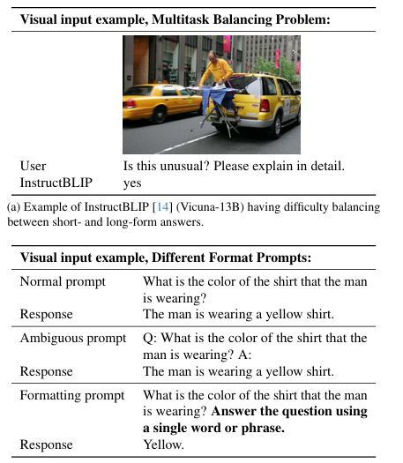
Approach
LLaVA uses a single linear layer to project the visual features to language space - optimizing an LLM for visual instruction tuning. However it lacks in short form answers (like with one word).
InstructBLIP has almost the opposite problem - overfitting to short-answer responses, even if a question asks for long-form answers
Inability to Balance between short and long form answers is caused by
Ambiguous prompts on the response format
Not fine tuning the LLMs to short vs long responses
To combat this, the authors want to use a single response formatting prompt which clearly outlines the type of response (short form or long form).
Fine Tuning to the length of response makes the output format adjustment much better

Slide 6
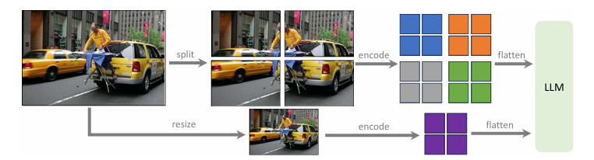
Scaling the Data
This image shows how the LLaVA model is scaled to higher resolution imagery.
The imagery is split into grids and encoded separately.
This allows the model to scale to any resolution, because it is broken down, and does not take into account the entire image
A downsized image is also encoded to give a global view of the image to the LLM to train on - the features of a downsampled image are concatenated to a merged feature map.
This is helpful because CLIP vision encoders limit the size of an image to 336^2.

Slide 7
Evaluation and Benchmarks
LLaVA-1.5 is evaluated on a collection of bench markers
VQA-v2 and GQA evaluate model’s visual perception
VizWiz contains 8,000 images to evaluate a model’s zero shot generalization on visual questions
Science QA uses multiple choice to evaluate zero shot generalizations
Text VQA contains text-rich visual questions
Instruction following LMMs do hallucinate to some degree
MME-Perception - evaluated model’s visual perception with a binary yes/no
MMBench - evaluate a model’s answer robustness with shuffling on multiple choice
SEED-Bench - evaluates performance on both images and videos with multiple choice
LLaVA-Bench In the Wild and MM-Vet evaluate a model’s ability to engage in visual conversations and evaluate the accuracy of the responses !

Slide 8
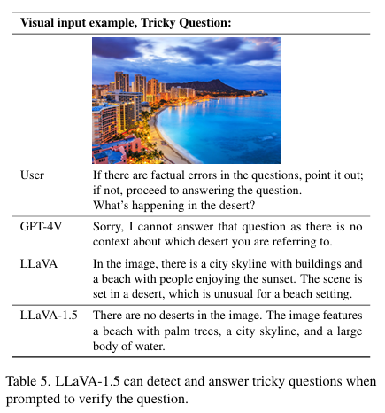
Results
LLaVA-1.5 achieve the best performance on all 12 benchmarkers
WHen image resolution is called up: performance has room for improvement on all tasks, especially for tasking using OCR (optical character recognition)
Main Result: LLaVA-1.5 achieves the highest performance with the simplest architecture, academic compute, and open source data. It is also fully reproducible and affordable
It also questions the idea that LMMs need significant training because they may be able to perform well with less pretraining

Slide 9
Emerging Properties
Generalizations:
LLaVA is not fine tuned for multilingual multimodal instructions, yet it is capable of following multilingual instructions.
Stronger base models = better results → LLaMA-2-based models (e.g. Vicuna-v1.5) perform better than LLaMA-1-based ones (e.g. Vicuna-v1.3)
Training style matters → LLaMA-2-Chat uses RLHF (reinforcement learning from human feedback) → Vicuna uses supervised fine-tuning (SFT)
Data diversity affects generalization → Vicuna-v1.5 generalizes better to non-English datasets (like MMBench-CN) due to multilingual ShareGPT data → LLaMA-2-Chat, trained mostly on English, performs worse on multilingual tasks
Task-specific strengths → Datasets like TextVQA benefit from real-world data (ShareGPT) that helps handle messy, OCR-related inputs

Slide 10
Challenges in LMMs
1. Data Efficiency
Even with half the training data, LLaVA-1.5 keeps over 98% of its performance
Some tasks even improve with less data → shows promise for “less-is-more” training
👻 2. Hallucination (Making Stuff Up)
LMMs may hallucinate when image resolution is too low
Higher-resolution inputs reduce hallucinations by helping the model “see” better
Key takeaway: balance between detailed data and the model’s ability to process it
🧩 3. Compositional Capabilities
LLaVA-1.5 can handle complex tasks by combining skills, even without training on every combination
But some challenges remain (e.g., describing object attributes or using foreign languages like Korean)
Suggests potential for more general reasoning without massive extra data

Slide 11
Conclusion
This work introduces LLaVA-1.5, a streamlined and data-efficient baseline for large multimodal models. Alongside its strong performance, the study explores key challenges, such as hallucination, resolution scaling, and compositional reasoning, offering practical insights and a reproducible foundation for advancing open-source multimodal research.

